Slide 1
Edmund Rice Awards for Secondary Schools

Slide 2
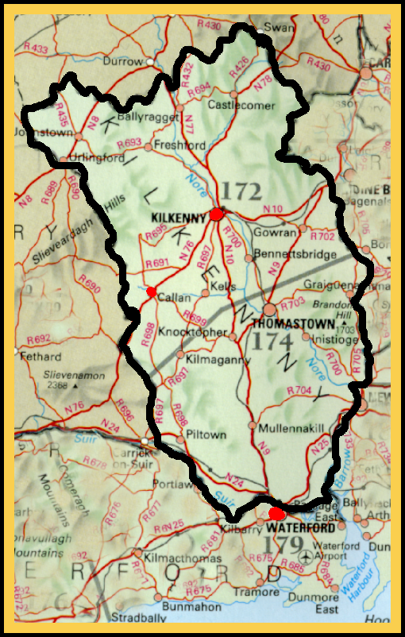
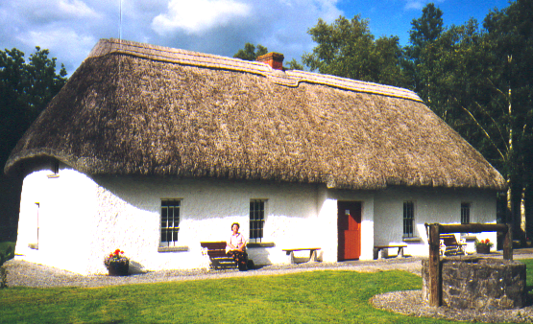
Edmund Rice
Born at Callan, Co. Kilkenny on Ist June 1762

Slide 3
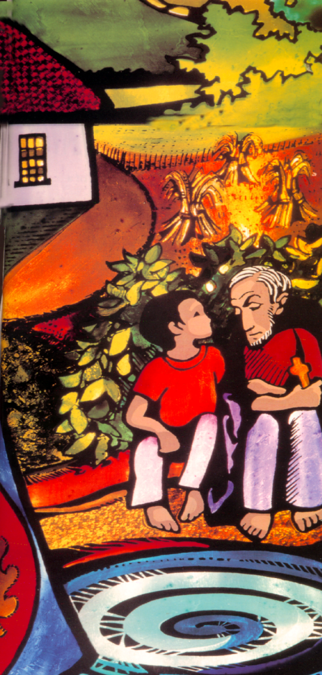
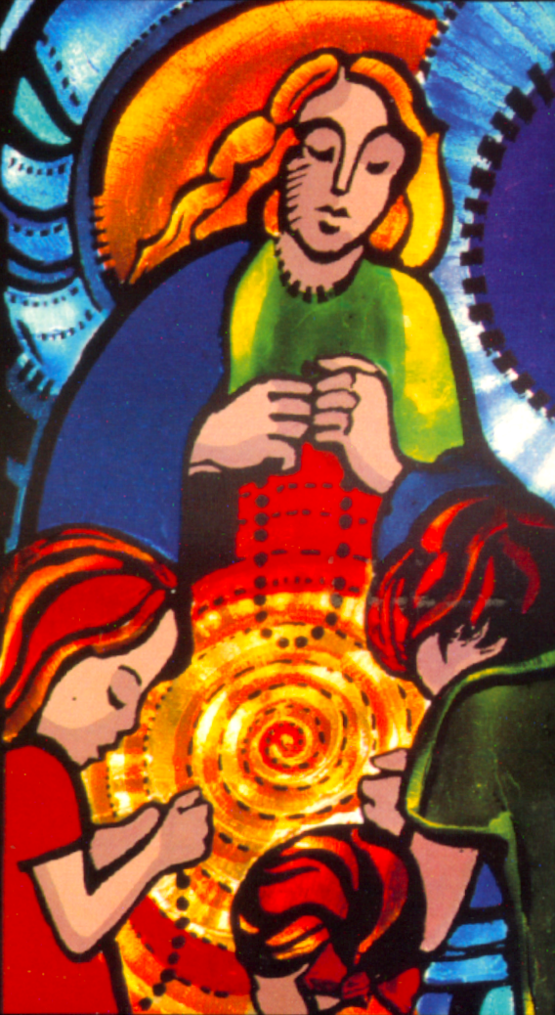
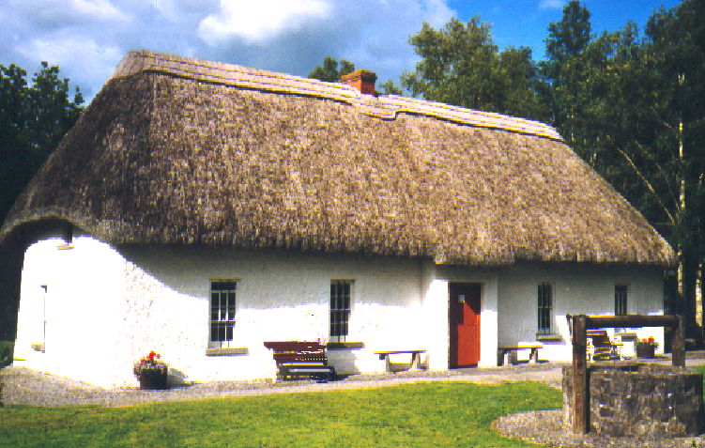
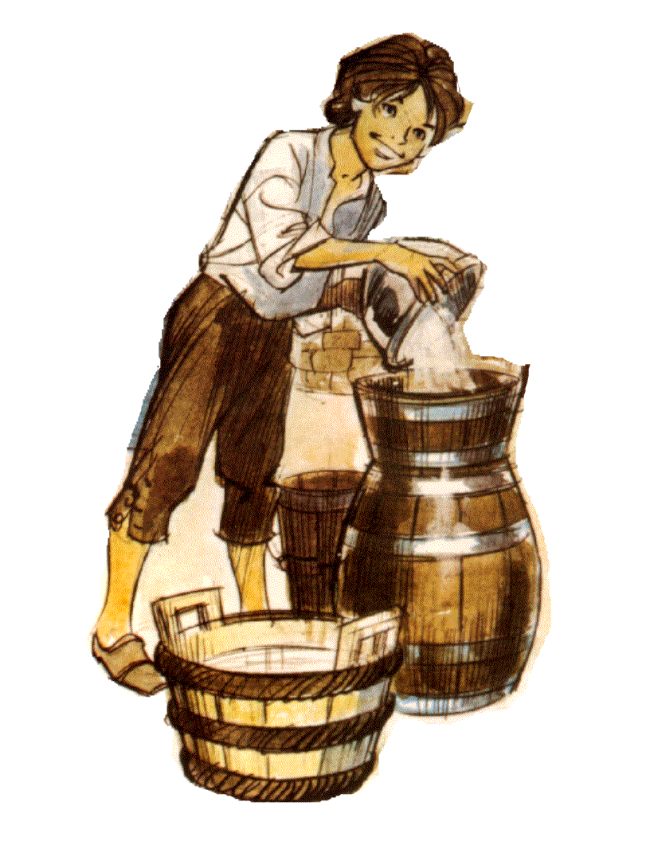
Edmund lived at home in Callan until he was 17

Slide 4
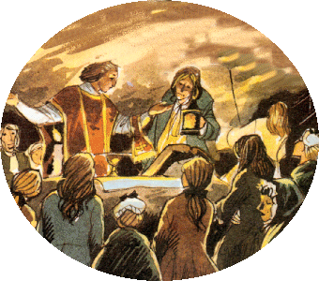
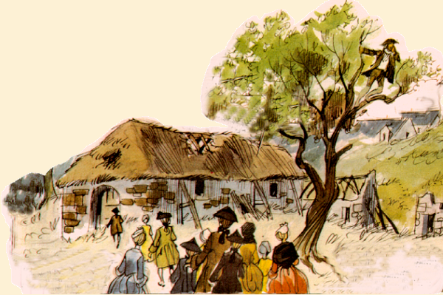
Going to Mass in Penal Days

Slide 5
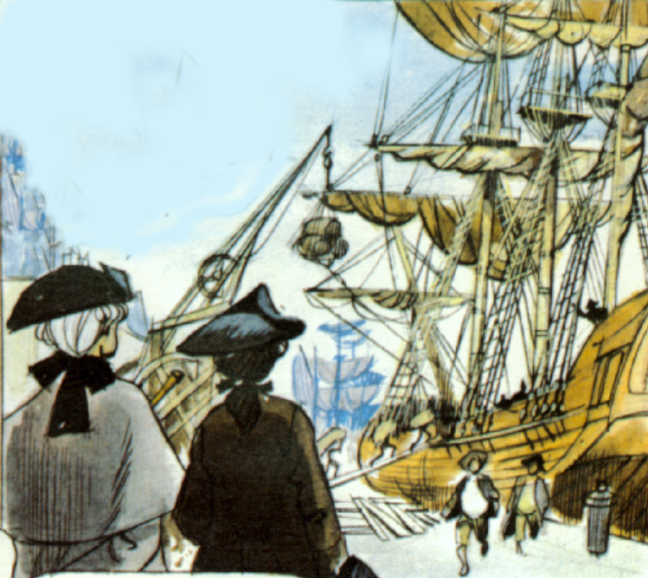
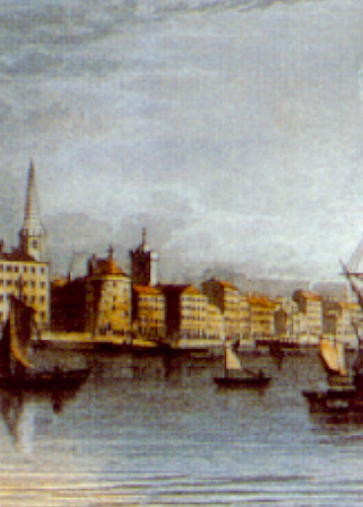
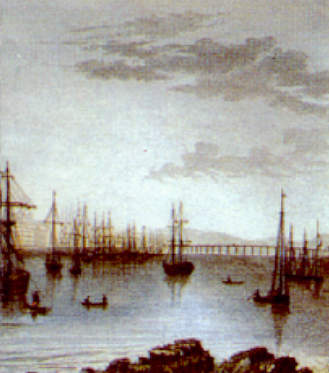
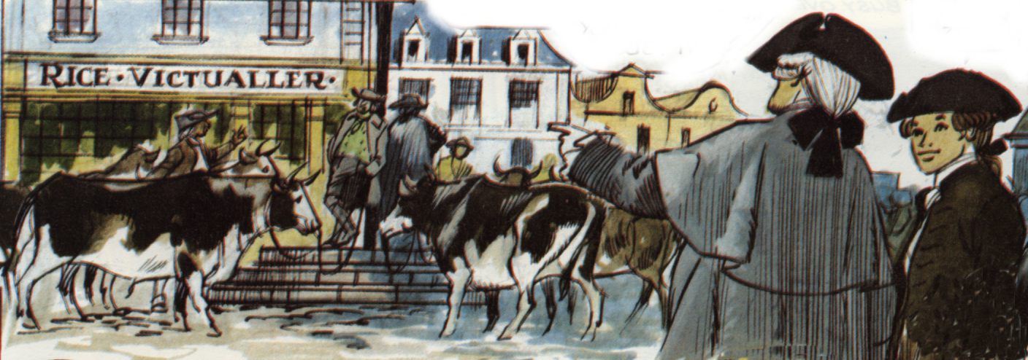
Waterford
Edmund learned his trade here

Slide 6
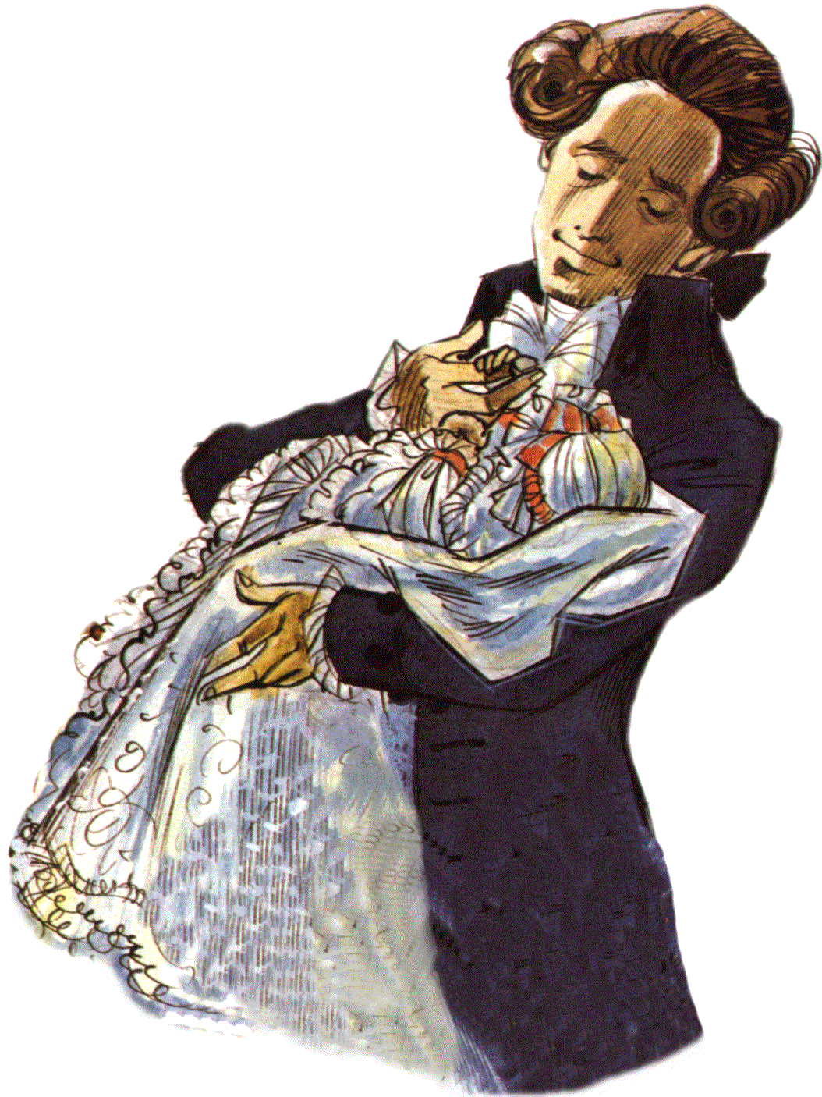
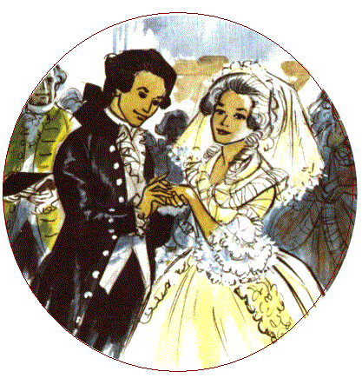
In 1785 Edmund married Mary Elliott……
….Mary died leaving Edmund with a baby daughter who was disabled.

Slide 7
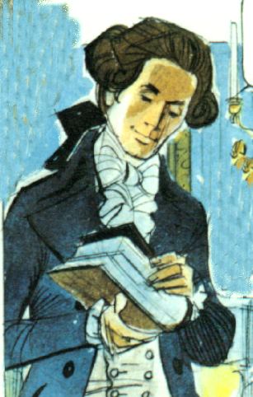
“The Lord gave, the Lord took away: blessed be the name of the Lord forever.”
Edmund’s sister Joan and other family members helped him to rear young Mary.

Slide 8
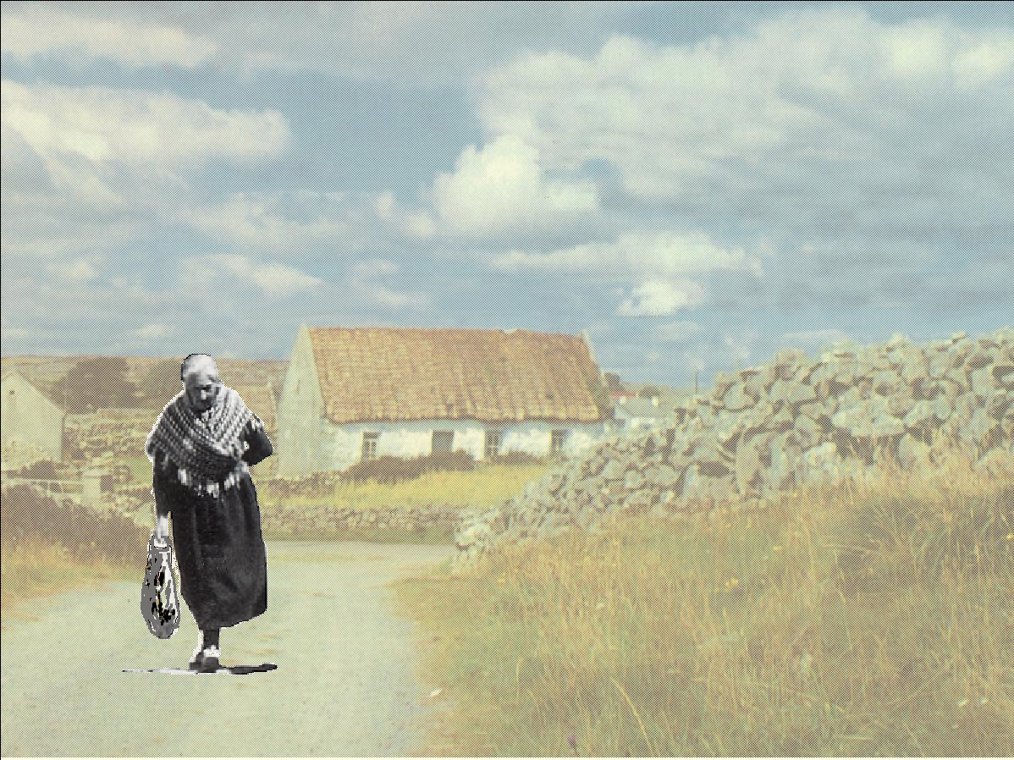
Edmund became more aware of the misfortunes of other people
Poll Carthy

Slide 9
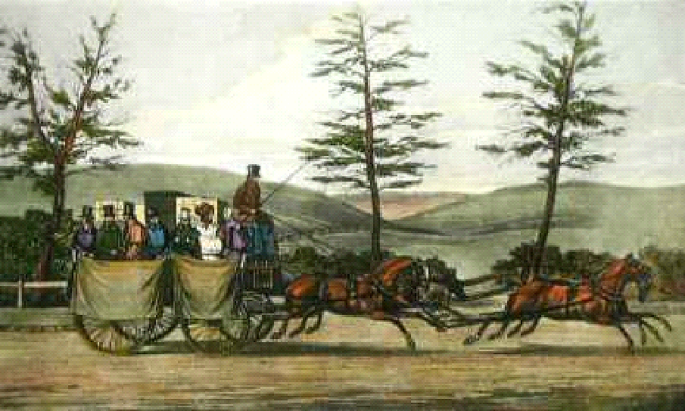
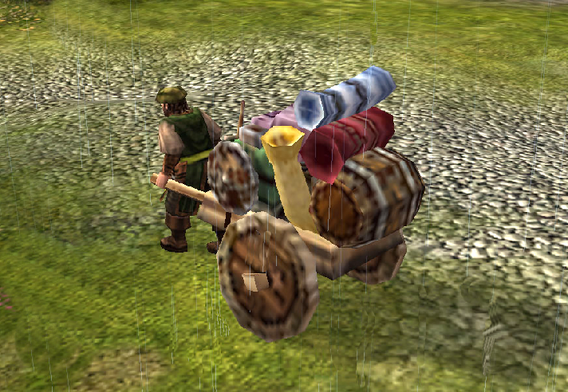
Carlo Bianconi

Slide 10
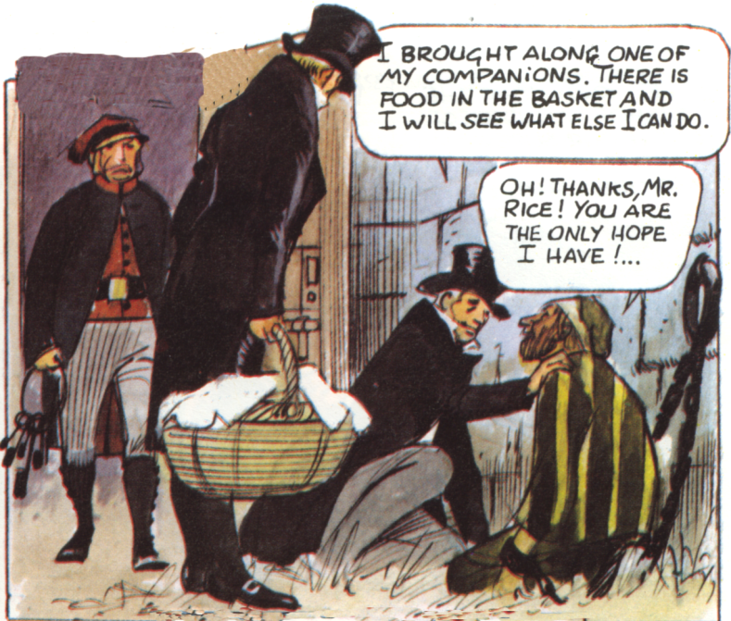
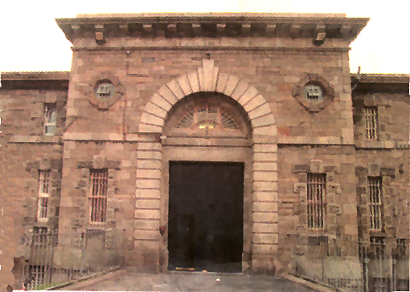
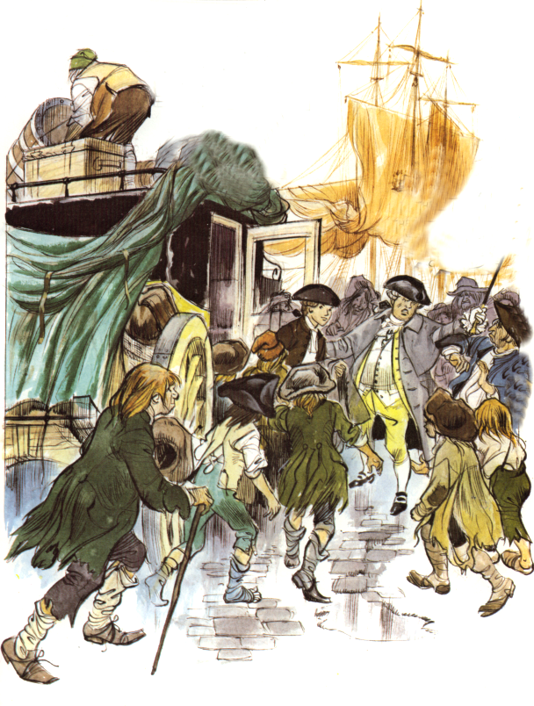
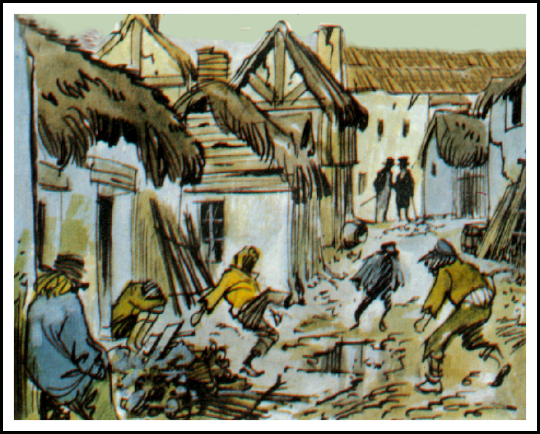
Prisoners
and their families

Slide 11
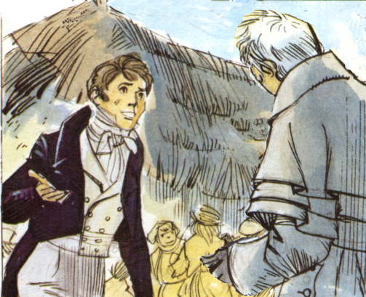
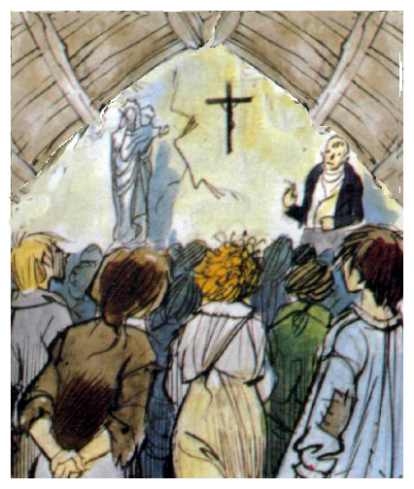
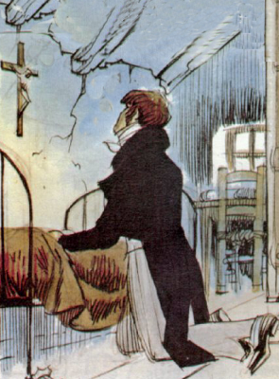
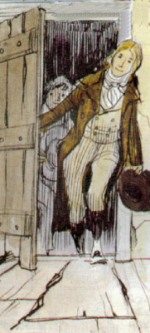
1802
A school in a stable
A home in a hay loft

Slide 12
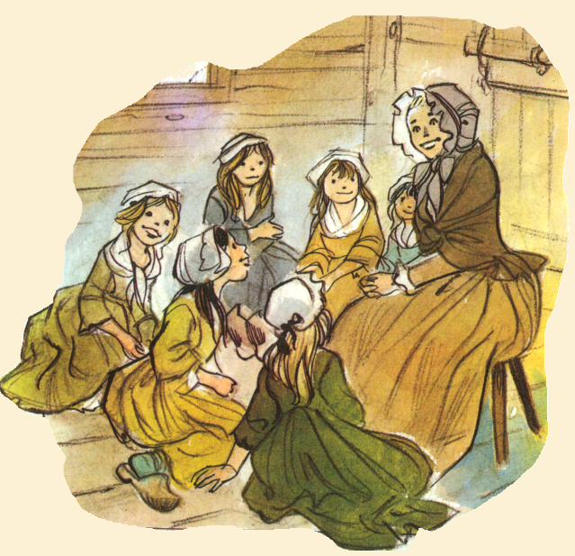
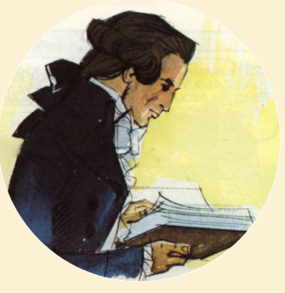
1798: A chance meeting brings Presentation Sisters to Waterford

Slide 13
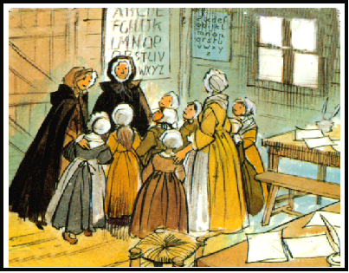
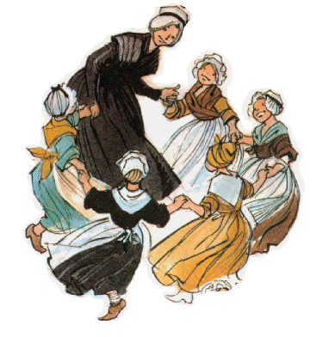
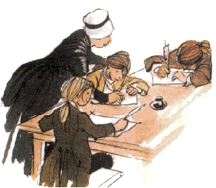

Slide 14
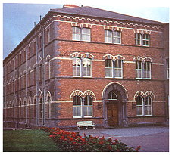
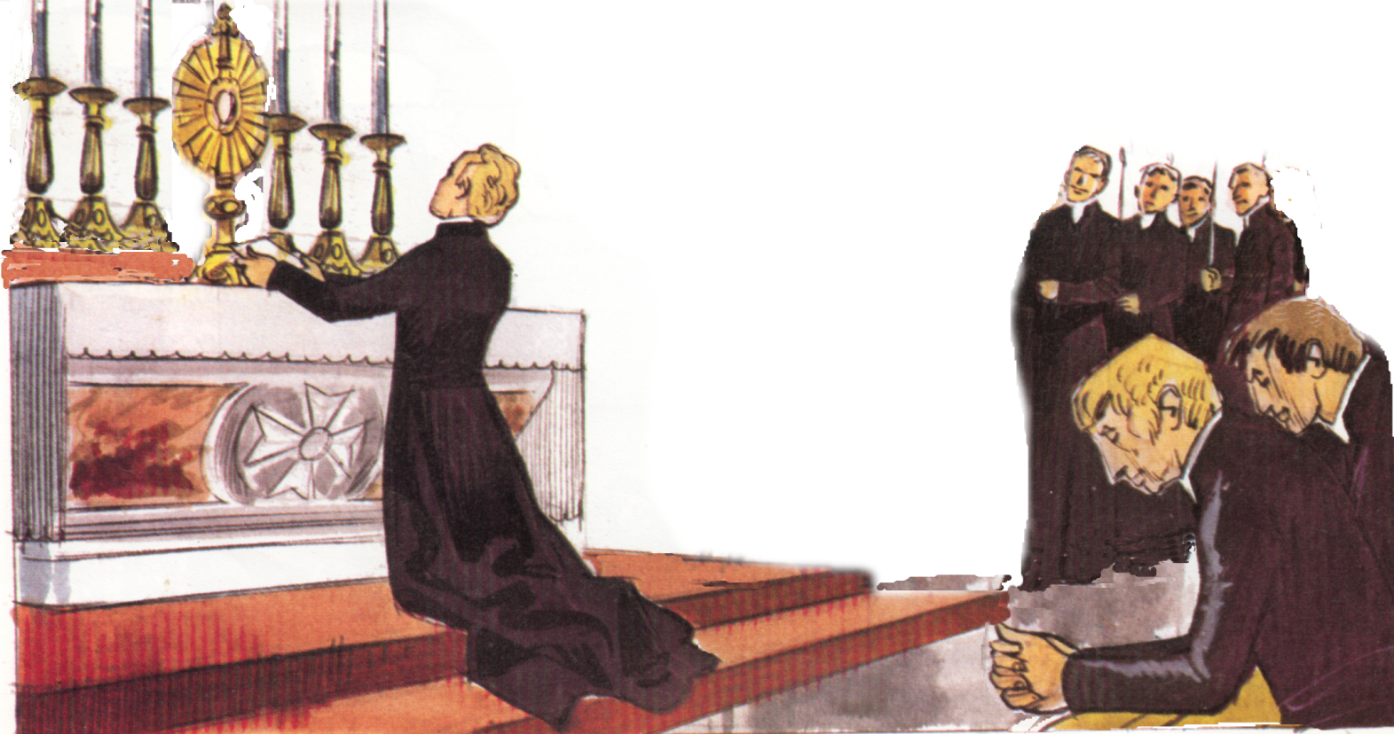
Mount Sion, Waterford
Society of the Presentation

Slide 15
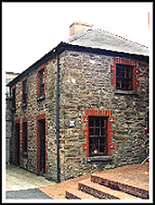
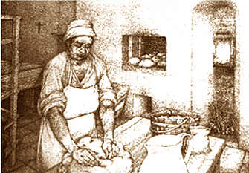
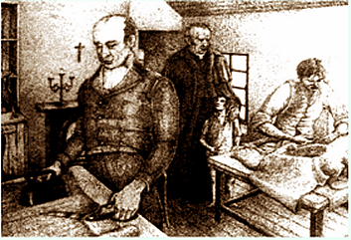
Education, a meal and dignity

Slide 16
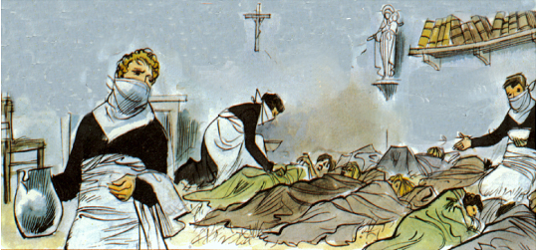
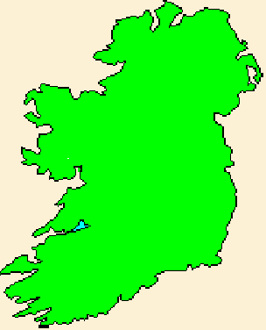
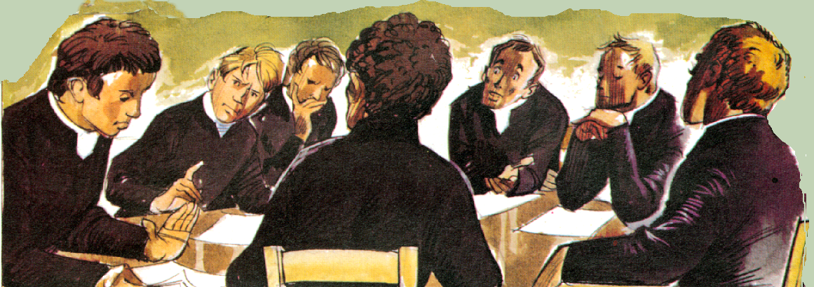
Problems
Waterford 1802
Carrick-on-Suir 1806
Dungarvan 1807
Cork City 1811
Dublin City 1812
Cappoquin 1813
Christian Brothers
Thurles 1816
Society of the Presentation
Presentation Brothers
Limerick City 1816

Slide 17
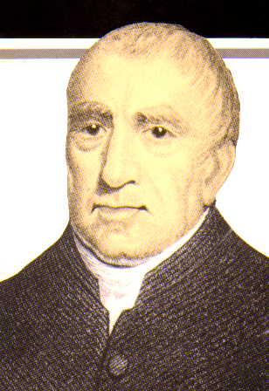
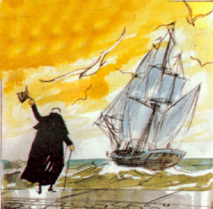
1843
Br. Rice was now 82 years old
21 Brothers’ schools in Ireland.
Brothers’ schools in England, Gibraltar, Australia and America

Slide 18
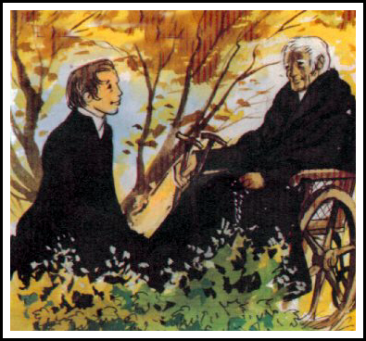
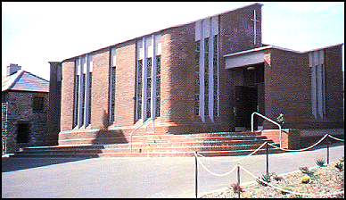
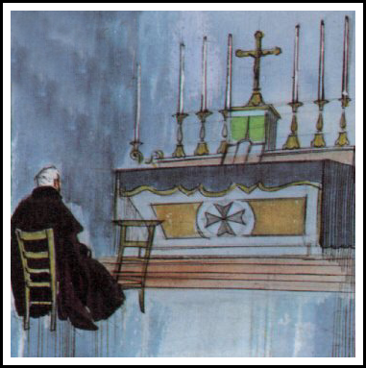
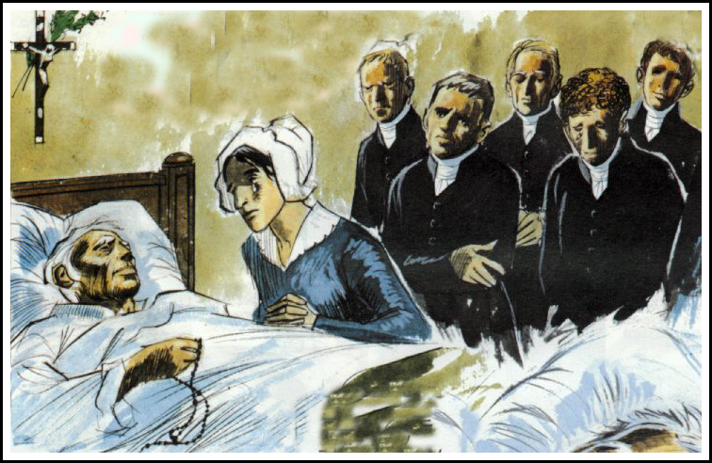
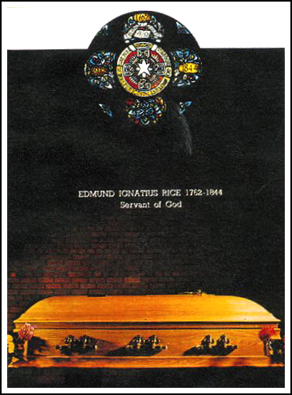
29th August 1844

Slide 19
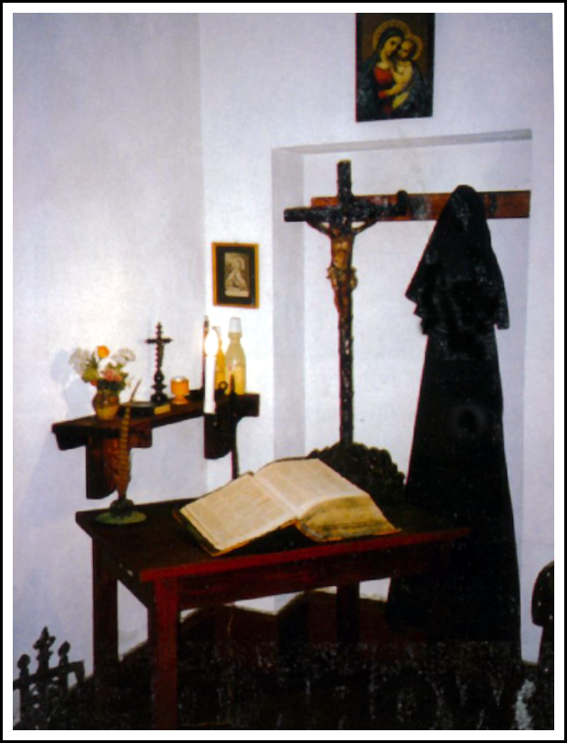
Relics
Pilgrims
Miracle
Kevin Ellison

Slide 20
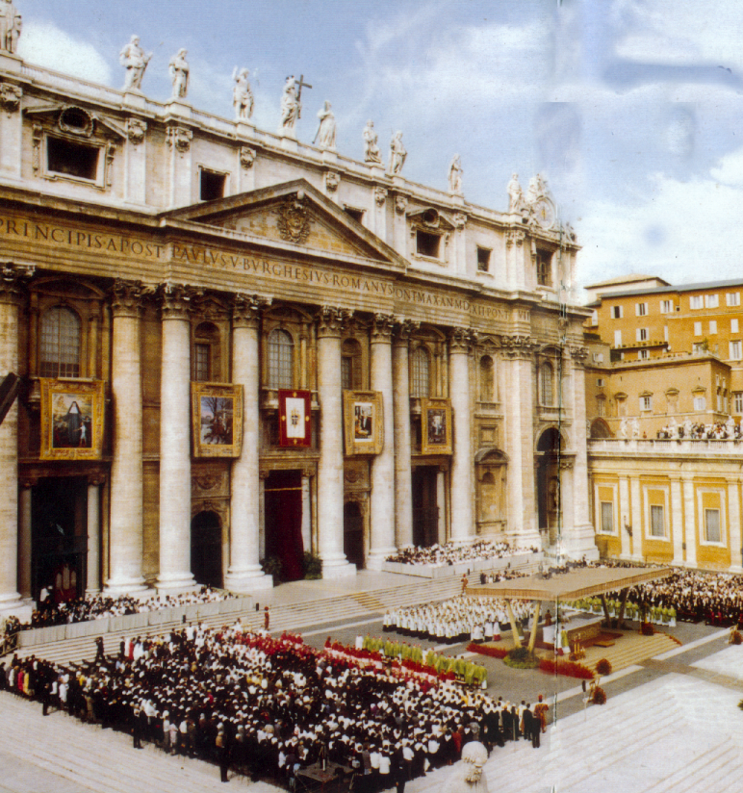
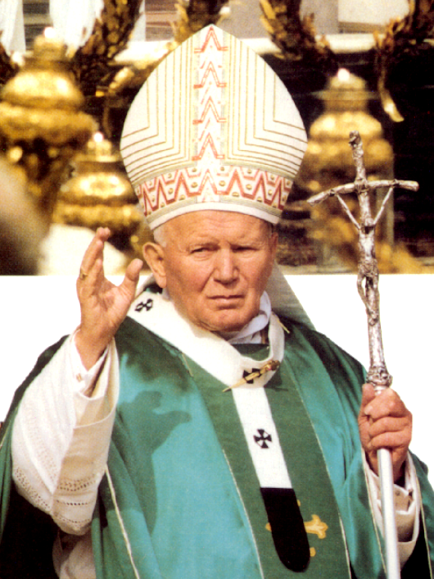
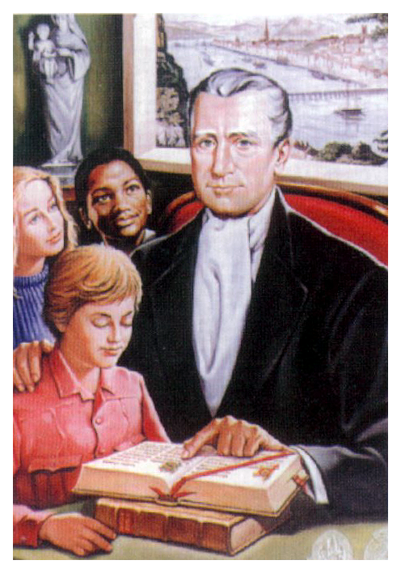
In a great ceremony in Rome on 6th October 1996, Pope John Paul II beatified Br. Edmund His official title is Blessed Edmund Rice and he is commemorated each year on 5th May. His many friends hope that soon he will be canonised and declared a Saint

Slide 21
Christian Brothers and Presentation Brothers have been going to foreign lands since Blessed Edmund's lifetime, and now carry on his work in all five continents.
Christian Brothers
Presentation Brothers
England.
Gibraltar.
England.
India
Canada
China
Canada
USA
USA
West Indies
Australia
Peru
Argentina
South Africa.
Ghana

Slide 22
In the footsteps of Blessed Edmund
“Were we to know the merit of only going from one street to another to serve a neighbour for the love of God, we should prize it more than gold or silver.” Bl. Edmund Rice

Slide 23
S.H.A.R.E.

Slide 26
Edmund Rice Action

Slide 27
Edmund Rice Awards for
Secondary Schools

Slide 28
“By having a chat with people I could make their day happier and put a smile on their faces…..”
“I have seen people drop out of school as a result of their drug problem. I have seen friends so drunk they can’t even talk. I felt I had a chance to make a difference………”
“ Writing letters to the people in Mountjoy prison was like making cushions to soften and comfort women like ourselves…”

Slide 29
Edmund Rice Awards for
Primary Schools

Slide 38
Presenting the Edmund Rice Awards 2005
ST. BRENDAN’S NATIONAL SCHOOL Birr, Co. Offaly

Slide 43
Scoil Mhuire na nGrás, Greenmount
Scoil Iosaef Naofa, Cobh
St. Joseph’s, Mardyke

Slide 50
THE MONASTERY NATIONAL SCHOOL Killarney Co. Kerry

Slide 54
SCOIL MHUIRE NATIONAL SCHOOL Miltown Co. Kerry

Slide 59
Edmund Rice Prayer
O God,
we thank you for the life of Edmund Rice.
He opened his heart to Christ
present in those oppressed by poverty and injustice.
May we follow his example of faith and generosity.
Grant us the courage and compassion of Edmund
as we seek to live lives of love and service.
We ask this through Christ our Lord.
Amen.

Slide 60
Mardyke House, Mardyke, Cork
October 2006

